Slide 1
Session 15
Chapter 6 – Database Modifications & Transactions
Database Systems

Slide 2
Objectives
1
Understand what are DDL, DML
2
Know how to write INSERT, UPDATE, DELETE queries
3
Understand what are transactions, COMMIT, ROLLBACK
4
Understand ISOLATION LEVELS

Slide 3
Contents
1
Insertions
2
Deletions
3
Updates
4
Transactions, COMMIT, ROLLBACK, ISOLATION LEVELS
5
Exercises

Slide 4
Review: Sub-languages of T-SQL
T - SQL
DDL
(Data Definition Language)
DML
(Data Manipulation Language)
DCL
(Data Control Language)

Slide 5
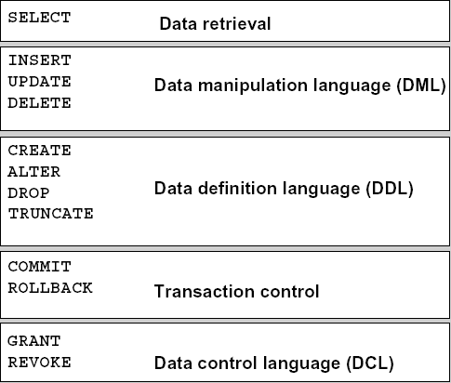
Review: Sub-languages of T-SQL

Slide 6
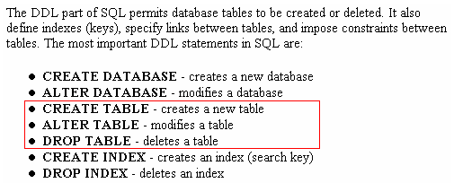
Review: DDL – Data Definition Language

Slide 7
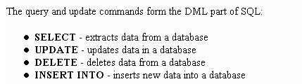
Review: DML – Data Manipulation Language

Slide 8
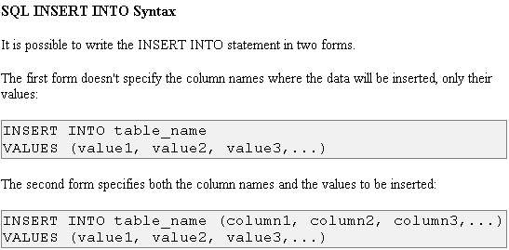
1 – Insertion with INSERT command

Slide 9
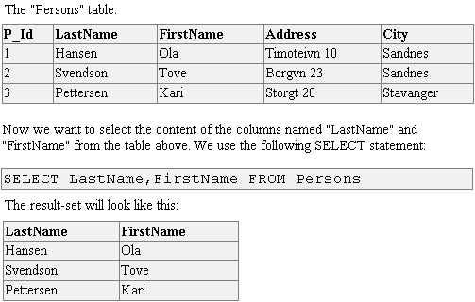
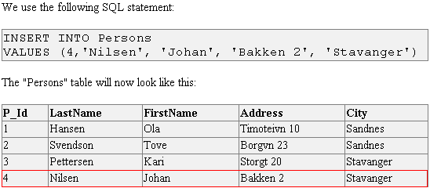
Example: Insert command

Slide 10
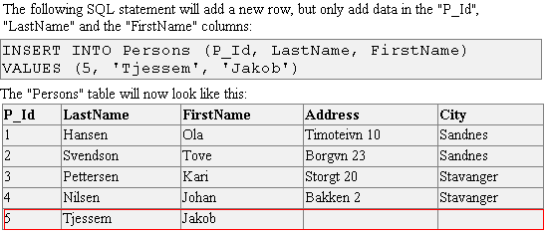
Example: Insert command

Slide 11
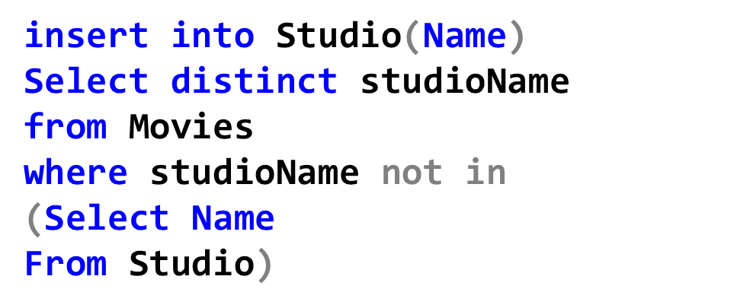
Insertion using tuples from subquery
We could use a subquery to compute a set of tuples to be inserted during the insertion

Slide 12
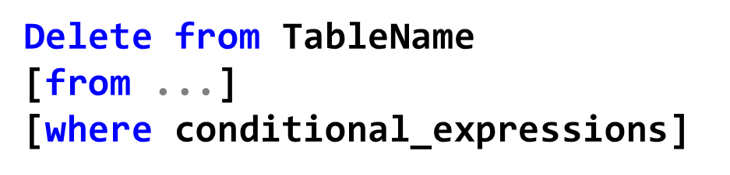
2 – Deletions with DELETE command
DELETE Syntax:
The conditional_expressions in WHERE clause allows to define which record(s) should be deleted. If you omit the WHERE clause, all records will be deleted.

Slide 13
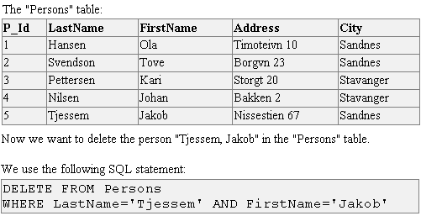
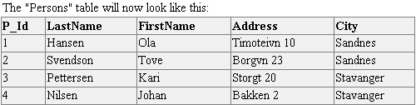
Example: Delete command

Slide 14
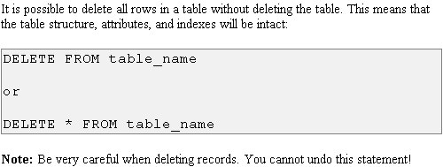
Example: Delete command

Slide 15
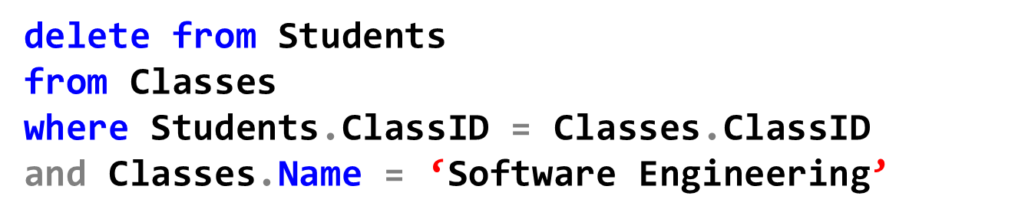
Example: Delete command
Sometimes you want to use attributes of other tables in the conditional expressions, in this case, list all other tables in the second FROM clause

Slide 16
Differences between DELETE and TRUNCATE
DELETE is DML statement
TRUNCATE is DDL statement
DELETE marks rows as deleted but the data file size is not decreased
TRUNCATE really deletes rows so the data file size is decreased
TRUNCATE TABLE [table name]

Slide 17
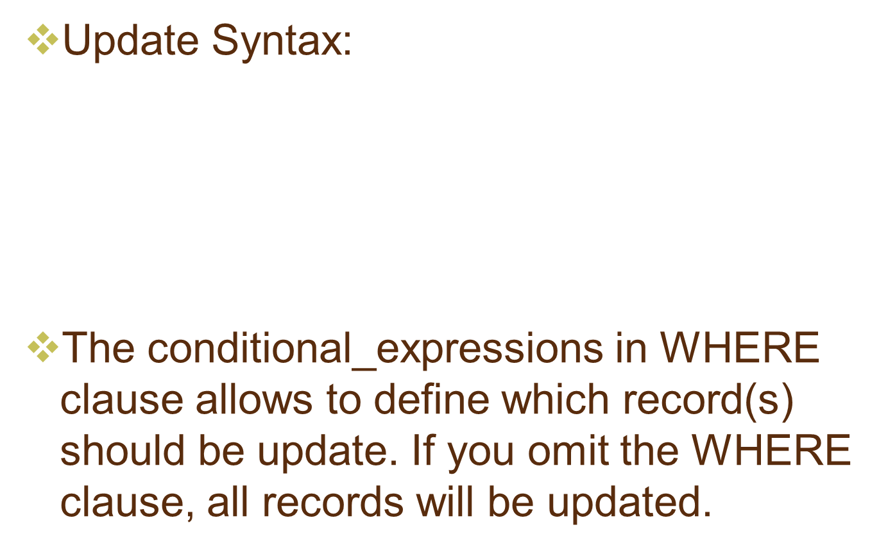
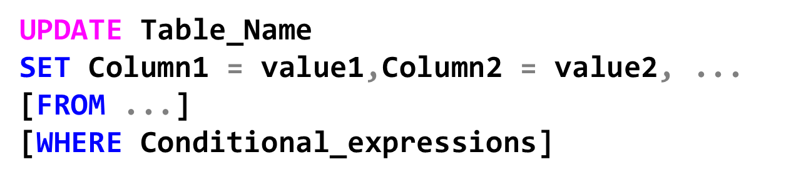
3 – Updates with UPDATE command

Slide 18
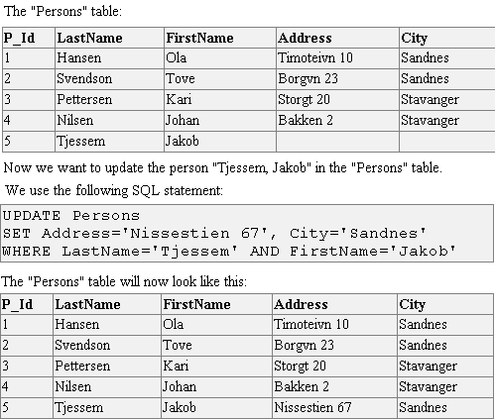
Example: Update command

Slide 19
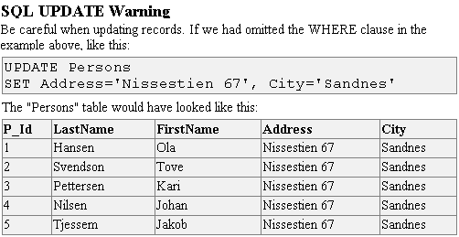
Example: Update command

Slide 20
4 – Transactions in SQL
A transaction is a sequence of SQL statements (executed by a single user) that together constitute a logical unit of work.
A transaction begins with the user’s first executable SQL statement.
A transaction ends when it is explicitly committed or rolled back by that user.

Slide 21
4 – Transactions in SQL
Transactions allow you to group SQL commands into atomic elements.
Essentially, they provide you with the capability of performing a series of commands in an "all or nothing" fashion.
The syntax for a simple transaction in SQL is rather basic:
BEGIN TRANSACTION
<SQL statements>
COMMIT

Slide 22
Example: Transaction
Consider a banking database. When a bank customer transfers money from a savings account to a checking account, the transaction can consist of three separate operations:
  decrease the savings account
  increase the checking account
  Record the transaction in the transaction journal

Slide 23
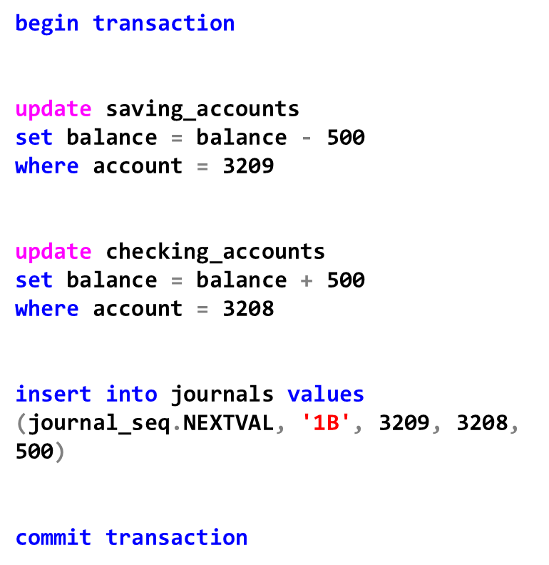
Example: Transaction
Begin Transaction
$500
ACC: 3209
Decrease the saving account
Increase the checking account
$500
ACC: 3208
Record in transaction journal
End Transaction

Slide 24
Example: Transaction
DBMS must guarantee that all three SQL statements are performed to maintain the accounts in proper balance.
When something prevents one of the statements in the transaction from executing (such as a hardware failure), the other statements of the transaction must be undone; this is called rolling back. If an error occurs in making any of the updates, then no updates are made.

Slide 25
Transaction integrity
Transaction integrity refers to the quality of a transaction as measured by its ACID properties.
There are 3-types of problems that violate transaction integrity (solving these problems involves enforcing various levels of isolation):
  Dirty reads
  Non-Repeatable reads
  Phantom rows

Slide 26
ACID properties of Transaction
The quality of a DBMS product is measured by its transactions’ adherence to the ACID properties. ACID is an acronym for 4 interdependent properties:
  Atomicity
  Consistency
  Isolation
  Durability

Slide 27
ACID properties of Transaction
Atomicity: The transaction must be atomic. This means that: ALL or NOTHING.
  At the end of the transaction, either all statements of the transaction is successful or all statements of the transaction fail.
  If a partial transaction is written to the disk then the Atomic property is violated

Slide 28
ACID properties of Transaction
Consistency: The transaction must preserve database consistency. This means that: the database must begin in a state of consistency and return to a state of consistency once the transaction is complete.
  Consistency means that: every row and value must agree with all constraints.
  For example: if the parent row is written to the disk but the child rows are not written to the disk, so the consistency property is violated

Slide 29
ACID properties of Transaction
Isolation: Each transaction must be isolated or separated from the effects of other transaction.
  Regardless of what any other transaction is doing, a transaction must be able to continue with the exact same data sets it started with.
  For example: Assume Joe is updating 100 rows, and while Joe’s transaction is under way, Sue delete one of rows Joe is working on. If the delete takes place, Joe’s transaction is not isolated from Sue’s transaction.
  This property is less critical in a single-user DB than in a multi-user DB

Slide 30
ACID properties of Transaction
Durability: The durability of a transaction refers to its permanence regardless of system failure.
  Once a transaction is committed, it stays committed. The DB product must be constructed so that even if the data drive melts, the DB can be restored up to the last transaction that was committed a split second before the hard drive died.

Slide 31
Transactional faults
The following transaction faults can potentially affect the integrity of the transaction:
Dirty read (most dangerous)
Non-Repeatable reads (medium dangerous)
Phantom rows (least dangerous)

Slide 32
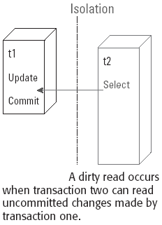
Transactional faults - Dirty read
The most egregious fault is a transaction’s work being visible to other transactions before the transaction even commit its changes
When a transaction can read another transaction’s uncommitted updates, this is called a dirty read.

Slide 33
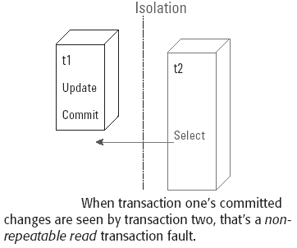
Transactional faults – Non-Repeatable read
A non-repeatable read is similar to a dirty read, but a non-repeatable read occurs when a transaction can see the committed updates from another transaction.
True isolation means that one transaction never affects another transaction. If the isolation is complete, then no data changes from outside the transaction should be seen by the transaction
Reading a row inside a transaction should produce the same result every time
If reading a row twice results in different values, that is a non-repeatable read fault

Slide 34
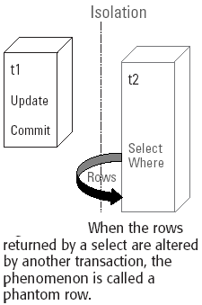
Transactional faults –
Phantom Rows
Like a non-repeatable read fault, a Phantom Rows Fault is when updates from another transaction affect not only the result set’s data value but also causes the SELECT to return a different set of rows

Slide 35
Isolation levels
Database deals with the 3 transactional faults by establishing isolation between transactions
The level of isolation, or the height of the fence between transaction, can be adjusted to control which transactional faults are permitted.

Slide 36
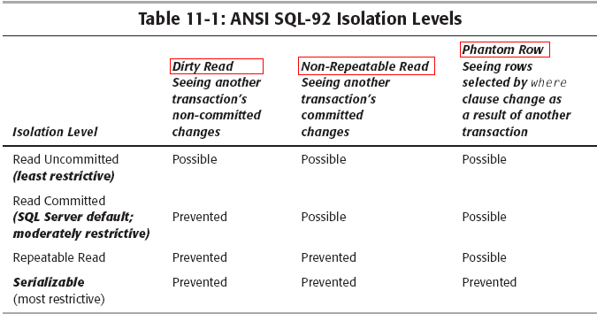
Isolation levels

Slide 37
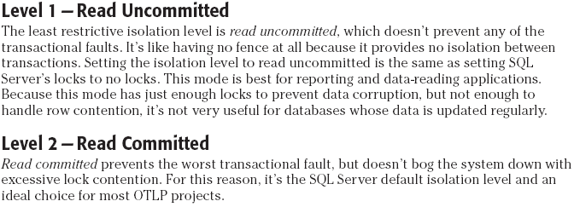
Isolation levels

Slide 38
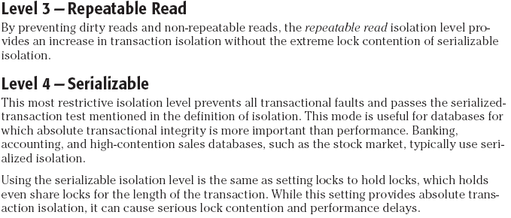
Isolation levels

Slide 39
Isolation levels
If you need to change the isolation model in use by SQL Server, simply issue the command:
SET TRANSACTION ISOLATION LEVEL <level>
where <level> is replaced with any of the following keywords:
  READ COMMITTED
  READ UNCOMMITTED
  REPEATABLE READ
  SERIALIZABLE

Slide 40
COMMIT, ROLLBACK
The changes made by the SQL statements that constitute a transaction can be either committed or rolled back.
Committing a transaction makes permanent the changes resulting from all SQL statements in the transaction. The changes made by the SQL statements of a transaction become visible to other user sessions’ transactions that start only after the transaction is committed.
Rolling back a transaction retracts any of the changes resulting from the SQL statements in the transaction. After a transaction is rolled back, the affected data is left unchanged as if the SQL statements in the transaction were never executed.

Slide 41
COMMIT, ROLLBACK
In SQL Server, every DML operation is a transaction whether it has a BEGIN TRANSACTION or not
To wrap multiple commands within a single transaction, a little code is needed. Two markers – one at the beginning of the transaction and the other at its completion. If the code detects an error, the transaction can be rolled back or Undone
BEGIN TRANSACTION: mark the beginning of a transaction
COMMIT TRANSACTION: finished the transaction and commit all the changes during the transaction.
ROLLBACK TRANSACTION: eliminate a transaction, the database returns to the state before the beginning of the transaction.

Slide 42
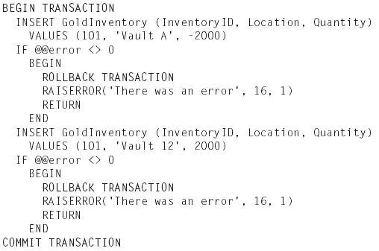
Example: Commit & Rollback

Slide 43
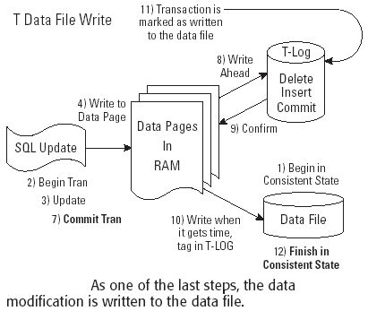
COMMIT, ROLLBACK
When the sequence of tasks is complete, the COMMIT TRANSACTION closes the transaction

Slide 44
Savepoints
For long transactions that contain many SQL statements, intermediate markers, or savepoints, can be declared. Savepoints can be used to divide a transaction into smaller parts.
By using savepoints, you can arbitrarily mark your work at any point within a long transaction. This gives you the option of later rolling back all work performed from the current point in the transaction to a declared savepoint within the transaction.
For example, you can use savepoints throughout a long complex series of updates, so if you make an error, you do not need to resubmit every statement.
SAVE TRANSACTION Savepoint_Name

Slide 45
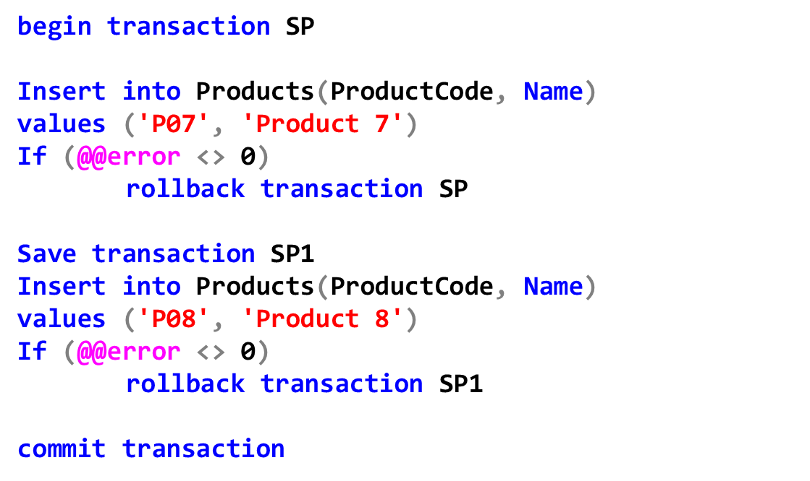
Example: Savepoints
Rollback the transaction SP
Rollback only to the savepoint SP1

Slide 46
SUMMARY
T-SQL includes: DDL, DML, DCL.
DML includes: select, insert, delete, update commands.
A transaction is a sequence of SQL statements that together constitute a logical unit of work
ACID is an acronym for 4 interdependent properties: atomicity, consistency, Isolation, durability
The following transaction faults can potentially affect the integrity of the transaction: Dirty read, Non-Repeatable reads, Phantom rows
Database deals with the 3 transactional faults by establishing isolation between transactions: READ COMMITTED, READ UNCOMMITTED, REPEATABLE READ, SERIALIZABLE
The changes made by the SQL statements that constitute a transaction can be either committed or rolled back.

Slide 47
Thank You !

